Slide 1
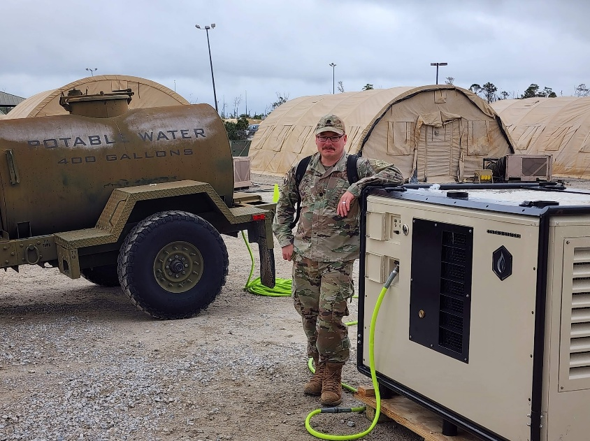
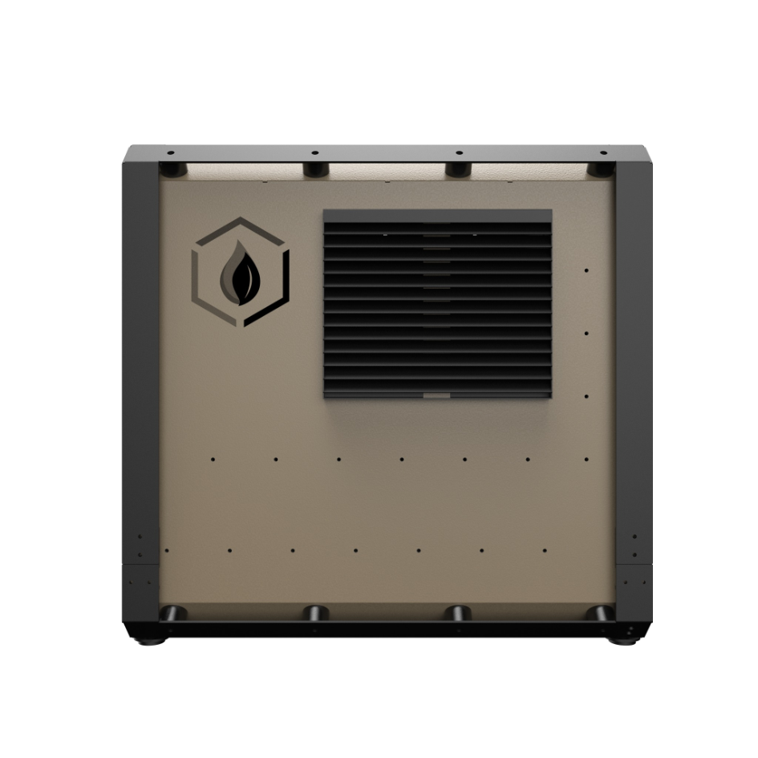
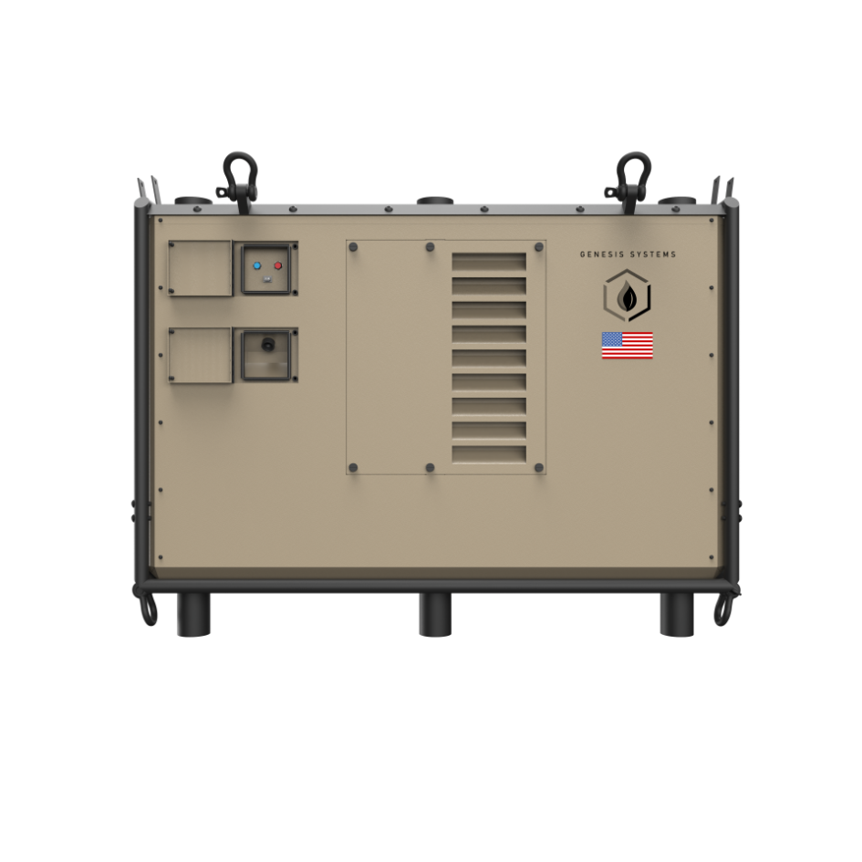
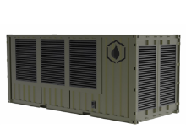
Unlimited Potable Water from the Air
CONFIDNETIAL//GRAY//NOT FOR PUBLIC
  Problem Statement:
  Warfighters need potable water within 72 hours for survival, but water transport is costly, inefficient, and vulnerable in contested environments. ROWPU systems are predictable, maintenance-heavy, and require frequent filter changes. WaterCube ® overcomes these challenges, supporting sustained operations in forward areas under ACE, MEU, and MDO concepts where mobility and operational freedom are critical.
  Project Description:
  Genesis Systems' WaterCube ® (Renewable Water from Air) technology, developed through partnerships with AFRL and Army Research Labs under five SBIR contracts over 6 years, is designed for military use.
  Benefit to Warfighter:
  Provides clean, reliable water at the point of need, eliminating water resupply, reducing unit footprint, and removing chlorine treatment. WaterCube ® enhances mobility and operational flexibility, ending reliance on external sustainment.
Water from Air at the Point of Need
Key Participants:
  Project Owner: USAFRICOM
  Industry Partner: Genesis Systems
  Sustainment Partner: INDOPACOM
  Other Stakeholders: USAFRICOM, USINDOPACOM, PACAF, HQ USAF, US Army DEVCOM, AFIMSC, 11th Air Task Force (ATF), 12th ATF, 13th ATF, 21st ATF, 22nd ATF, 23rd ATF, 270th CAOS, USMC 3rd Littoral Battalion, 8th Theater Sustainment Command
Key Deliverables:
  41 WC-1000M WaterCube® one thousand gallon per day systems
  118 WC-100M WaterCube® one hundred gallon per day systems
  422 WC-10M WaterCube® ten gallon per day water generator systems
    All military WaterCube® systems are EMP/Cyber hardened
    Parts benchstock for maintenance and repair sustainment
$50M APFIT funding will provide ramp up capability and initial procurement of 39 systems by Q4 FY26 with full delivery of 581 systems by Q4 FY29. INDOPACOM will continue procurement and sustainment using POM’d funding (table).
Funding ($M) | Past | FY25 | FY26 | FY27 | FY28 | FY29 | FY30
APFIT | $0.0 | $0.0 | $50.0
Procurement (Phase III) | $0.6 | $0.5 | $15.0 | $36.0 | $57.0 | $78.0 | $99.0
Other Partner (RDT&E) | $6.8 | $2.0 (TACFI) | $14.0 (Catalyst) | $30.0 (STRATFI)
Other Partner (O&M) | $0.0 | $0.0 | $9.75 | $5.4 | $8.55 | $11.7 | $14.8
Schedule:
  Additional Facility Standup – Production ramp-up Q2 FY26
  Initial delivery of 39 WaterCube ® systems Q4 FY26
  Achieve full rate production Capability Q1 FY27
  Mid Point Production – 292 WaterCube ® systems delivered Q4 FY28
  Remaining of 581 WaterCube ® systems delivered Q4 FY29
CONFIDNETIAL//GRAY//NOT FOR PUBLIC
Genesis Systems LLC, Herschel.Campbell@Genesissystems.com, 713-416-5669
Name of APFIT PM, e-mail, phone
Notes:
Quad Script:
Ladies and gentlemen, our forces need potable water within 72 hours to survive. Right now, that water is expensive to move, inefficient to sustain, and highly vulnerable in contested environments. Convoys and resupply missions put people at risk, and legacy ROWPU systems are predictable, maintenance-heavy, and require constant filter changes.
Genesis Systems’ WaterCube technology changes that equation. Built through partnerships with AFRL and the Army Research Lab, this system pulls clean, potable water directly from the atmosphere. It eliminates the need for water convoys, reduces logistics and footprint, and gives commanders true operational flexibility.
The capability is proven. We’re delivering one-thousand-gallon-per-day WC-1000M systems, along with smaller ten-gallon-per-day WC-10Ms for distributed operations. Every system is EMP and cyber-hardened, with sustainment and bench stock support built in.
We have a defined path forward: APFIT funding in FY26 to ramp production, initial delivery of 39 systems that same year, and over 581 units fielded by FY29. INDOPACOM will sustain using programmed funding.
Bottom line: WaterCube gives us unlimited potable water at the point of need. This is about enhancing combat power, protecting our Airmen, and ensuring we can operate and survive wherever the mission takes us.”*

